Slide 1
Spring Chinook Salmon in the Portland Metro Area
Jenny Kaylor, Josh Williams, Jay Hastings, Erica , and Courtney Muhlbach

Slide 2
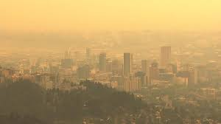
Hypothesis
Does pollution have an affect on the salmon population?

Slide 3

Goal: Spring Chinook Salmon vs. Water Relationship
Notes:
Our goal is to understand the “2005-2019” water’s effecy on the Native Chinook Salmon Populations in he “Lower Columbia” area during their migration cycle to spawn in the “Spring”.

Slide 4
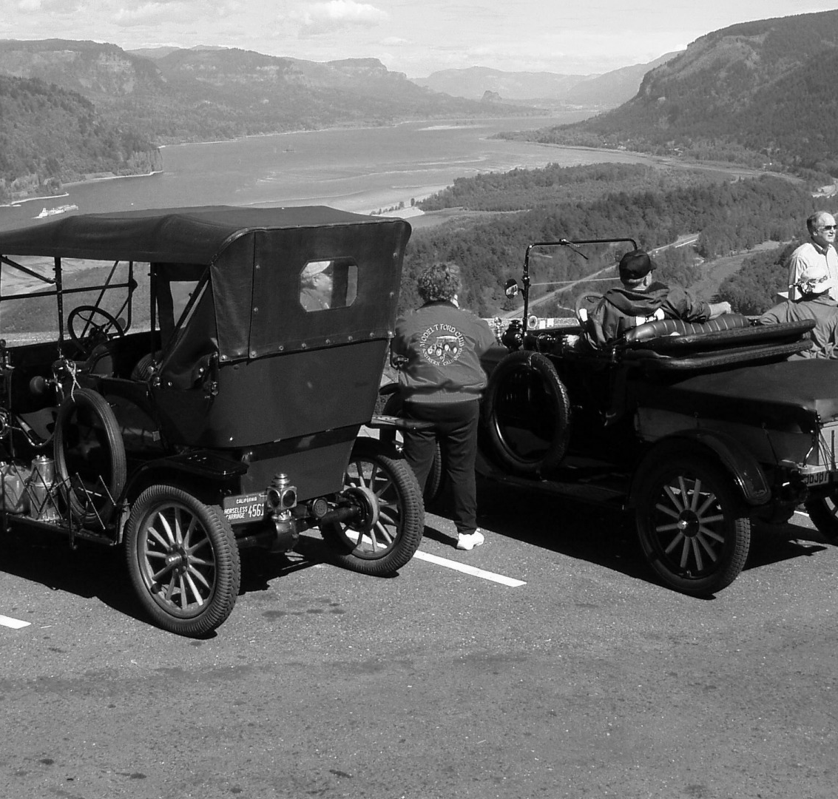
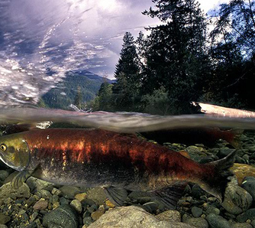
Background
Salmon
Rivers
Cities
Dams
Oh My!
Notes:
Salmon facts:
Salmon like a very narrow range of temperatures
The Columbia River is one of the world’s largest hydropower systems
There are over 450 dames throughout the entire Columbia River system
The Chinook salmon of the Columbia River has been classified as an endangered species
Many factors affect the water temperature/Snow pack/Population/Pollution/Gage
Young juvenile salmon or smolts seem to like warmer water, unless it is hot outside, then they seek cooler water
In the fall juvenile salmon move downstream to avoid colder water upstream
Spring chinook are even more sensitive than a lot of other fish
During the spawning migration, temperature is a critical environment factor. High water temps can delay or even halt fish migration
Spring Chinook like to spawn in May-June and the ideal temp is 40-50 degrees f
If the chinook salmon is shocked thermally (unideal temp) it will often be preyed upon by larger fish

Slide 5


Proposal
Or?
Notes:
Target whether this has been effective
What are the ideal water conditions for catching salmon

Slide 6


Questions Asked
Will Spring Chinook Salmon be here for our grandchildren?
What data do we have?

Slide 7

Data Clean up and Exploration
Google misery
Too many sources – is it relevant data?
Data inconsistencies – so many formats
Making sure our shapes matched up – working with teams
Scrubbing, Scrubbing, Scrubbing

Slide 8
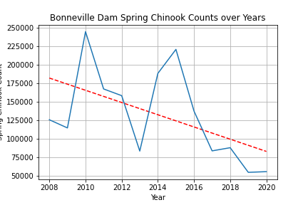
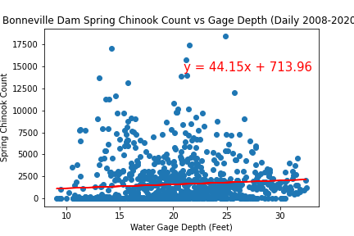
Data Analysis

Slide 9
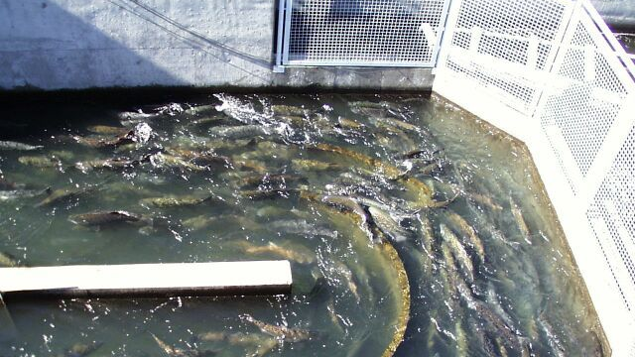
Post Mortem

Slide 10
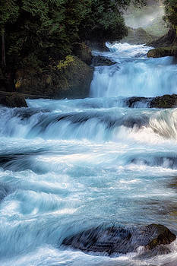
Questions?

